Slide 1
Introduction to Simulation and Modeling

Slide 2
Project Planning
(Lecture 8)

Slide 3
Introduction
When the commissioning organization has decided to proceed with the simulation project, the practitioner may suddenly be thrust into the position of project manager.
Success or failure of a simulation project can depend heavily on the amount of time and skill devoted to the planning phase of the project.
These topics are organized into the following sections:
Project management concepts
Project manager functions
Work breakdown structures
Linear responsibility charts
Scheduling and the Gantt chart

Slide 4
Project Management Concepts
In this section we discuss concepts fundamental to the practice of project management. These concepts include:
Project parameters
Project life cycles
Project stakeholders

Slide 5
Project Parameters
The success or failure of a project is frequently measured by three standard project parameters. These are:
Time
Cost
Technical performance

Slide 6
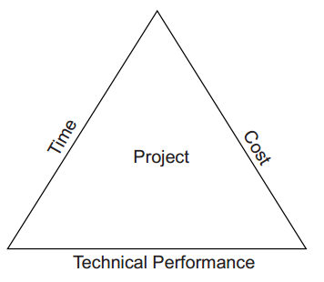
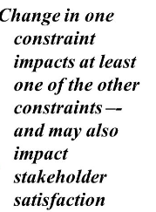
Project Parameter Model

Slide 7
Time Parameter
The time parameter is associated with the project schedule, which is most frequently implemented as a Gantt chart.
While the project is progressing, the project manager should be regularly comparing the actual project progress with the project schedule.
If there are significant differences between the actual project progress and the project schedule, something may be amiss.

Slide 8
Time Parameter
If the project is continuously ahead of schedule, the following situations may exist:
The budget is being consumed at an excessive rate.
Excess resources are assigned to the project.
The technical performance standards are being compromised.
The project is much less complex than originally estimated.

Slide 9
Time Parameter
Conversely, if the project is continuously behind schedule, any of the following situations may be present:
Expenditures are being delayed.
Insufficient resources are assigned to the project.
The technical performance standards are being exceeded.
The project is much more complex than originally estimated.

Slide 10
Cost Parameter
The cost parameter means that there is a budget associated with the project.
Simulation project costs may include:
  computer hardware and software.
  practitioner’s time or the time of other resources needed to complete the project
  Cost of collecting original data

Slide 11
Cost Parameter
If project is continuously under budget, the following situations may be present:
Expenditures are being delayed.
Insufficient or inexperienced resources are assigned to the project.
The technical performance standards are being compromised.
The project is much smaller or less complex than originally estimated.

Slide 12
Cost Parameter
Similarly, problems may also exist if the project is continuously overbudget. Typical causes are:
The budget is being consumed at an excessive rate.
Excess resources are assigned to the project.
The technical performance standards are being exceeded.
The project is much larger or more complex than originally estimated.

Slide 13
Technical Performance Parameter
Finally, the project will have technical performance objectives.
These would normally be specified in the problem statement phase of the project
If the technical performance parameters are not achieved, then the project manager should first check whether:
  Expenditures are being delayed.
  Insufficient or inexperienced resources are assigned to the project.
  Technical performance standards are unnecessarily demanding.
  The project is much larger or more complex than originally estimated.

Slide 14
Technical Performance Parameter
On the other hand, if the technical performance parameters are constantly exceeded, any of the following situations could be occurring:
The budget is being consumed at an excessive rate.
Excess resources are assigned to the project.
Technical performance standards were originally insufficient and must be revised.
The project is much smaller or less complex than originally estimated.

Slide 15
Project Life Cycles

Slide 16
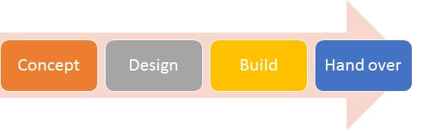
Project Life Cycles
There is some thought that all projects proceed through certain life-cycle phases in some form or another.
The following phases are commonly recognized:
Conceptual
Planning
Execution
Completion

Slide 17
Conceptual
Initial decision by someone in the organization to consider conducting the simulation study.
During this phase, the organization will formally assign the project to the project manager.
The problem formulation process may be completed during this life cycle phase.

Slide 18
Planning
Project manager will identify all of the project team members.
The simulation-planning process activities involving the work breakdown structure, linear responsibility chart, and Gantt chart are conducted during this life-cycle phase.

Slide 19
Execution
Most of the simulation project activities for the project will be completed during the execution life-cycle phase.
These include the system definition, input data collection and analysis, verification, validation, experimentation, and analysis.

Slide 20
Completion
The completion phase activities are normally conducted after most of the technical project activities have been concluded.
These activities are associated with turning over the results of the project and primarily include the simulation project report and presentation activities

Slide 21
Project Stakeholders
Every project has what are known as stakeholders (Cleland and Ireland, 2002).
Stakeholders are individuals or organizations who have some sort of vested interest in the ongoing operations or completion of the project.
Stakeholders can be categorized as either internal or external. The perspective is from the viewpoint of the simulation project team.
Internal Stakeholders
External Stakeholders

Slide 22
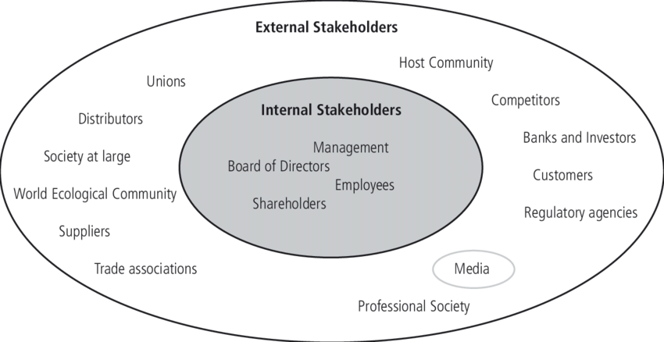
Project Stakeholders

Slide 23
Internal Stakeholders
Individuals who are directly associated with the simulation project team.
This can also be interpreted as individuals over whom the practitioner/project manager exercises some degree of control.
Specific examples of internal stakeholders include:
Practitioner/project manager
Analysts
Data collectors
Functional managers who supervise the project team members

Slide 24
External Stakeholders
Individuals or organizations who are not directly associated with the simulation project team.
They can be within the parent organization but outside of the simulation project team, or they can be completely external to the parent organization.
Specific examples of external stakeholders include:
Practitioner/project manager’s manager
Managers of the process modeled
Workers in the process modeled
Simulation software vendor/developer
Equipment vendors and manufacturers
Regulatory agencies
Competitors
Public or community in general

Slide 25
Summary
Any Questions?

